Slide 1
Deep Dive Tableau Server Stats (Postgres)
TUG DELHI Meetup – Feb, 2020

Slide 2
List of Topics
About me
What is Postgres
How to enable Postgres access
How to connect to Postgres
Workgroup Database
Data Dictionary
Creating Data Sources
Common Use Cases
ER Diagram

Slide 3
About Me
Name: Manish Kumar
Professional Experience:
Data Visualization – ~3 Years
Quality Assurance – 12 Years
Certifications:
Tableau Desktop Certified Associate (2017)
PMP (2013)
ISTQB (2012)
Hobby:
Playing & watching Tennis
Contribution to DelhiTUG
First attended in August, 2018
Presented 6x on different Data related topics

Slide 4
What is Postgres
PostgreSQL, also known as Postgres, is a free and open source relational database management system
The Tableau Server repository is a PostgreSQL database that stores data about:
Published Workbooks / Data Sources
All user interactions – Login, Viewing/Publishing activity etc
Server Permissions
Extract refreshes
Schedules
Alerts

Slide 5
How to enable Postgres access
Server Admin can enable access to the Postgres repository via TSM command; post which any user can connect to it to create data Visualizations
tsm data-access repository-access enable --repository-username readonly --repository-password <PASSWORD>
Default users:
tableau
Readonly
Database name:
workgroup

Slide 6
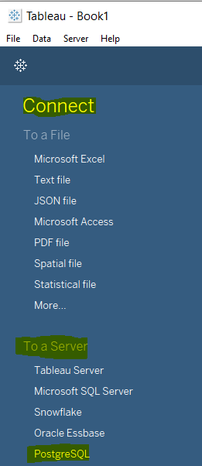
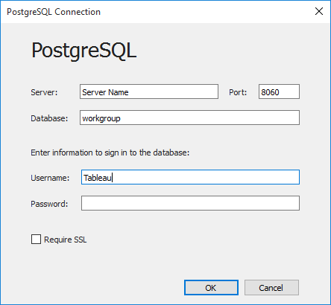
How to connect to Postgres

Slide 7
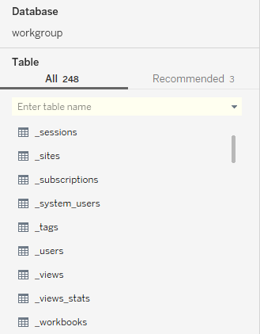
Workgroup Database
Consists of tables with below names:
_<table_name>
_hist<table_name>
Workgroup Data Dictionary:
https://tableau.github.io/tableau-data-dictionary/2019.4/data_dictionary.htm

Slide 8
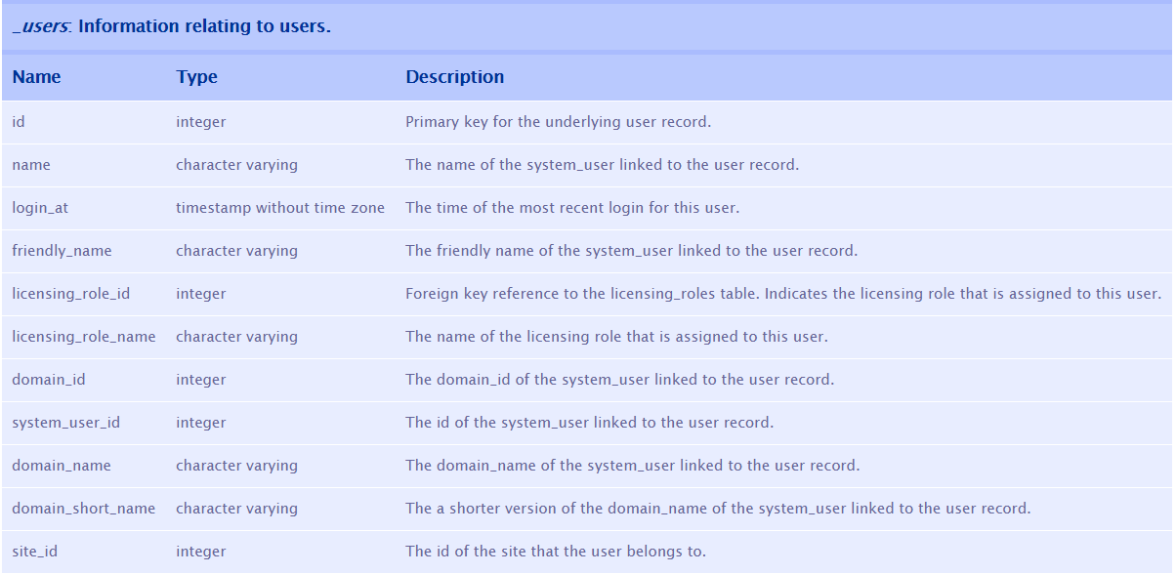
Data dictionary: _users table

Slide 9
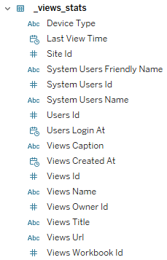
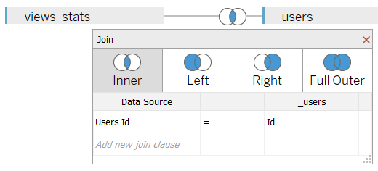
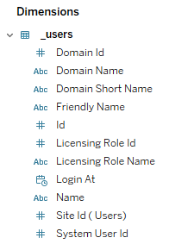
Creating Data Sources

Slide 10
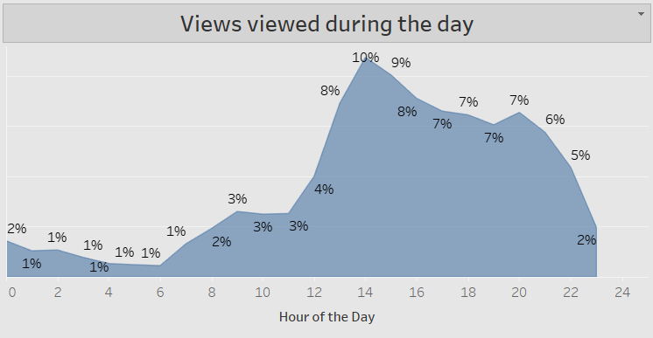
Common use cases
What time of the day are users viewing the views?
Current Vs Forecasted Activity
Desktop Vs Device usage
Most Active Users
Most Viewed Views
What are the different data sources our users are using?
What time of the day my extracts are running?
Overall volume of data refreshed daily?

Slide 11
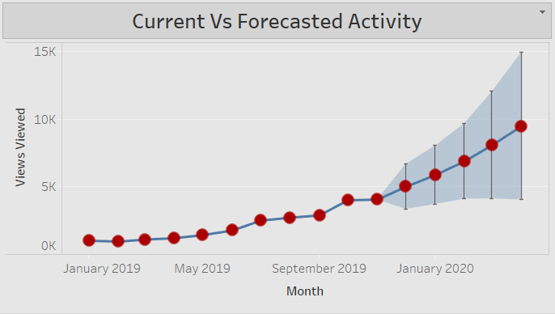
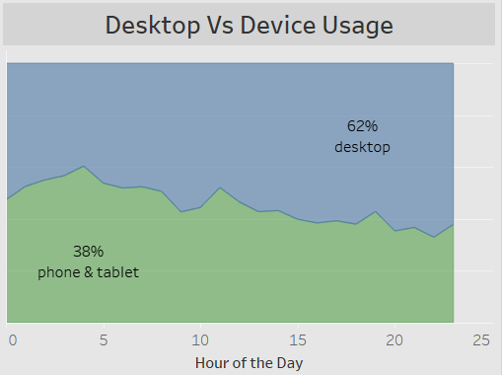
Common use cases

Slide 12
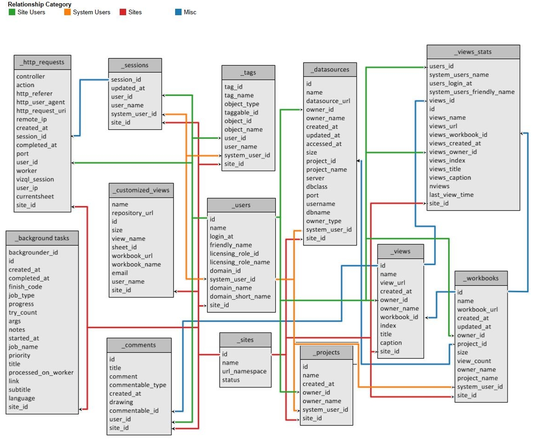
ER Diagram

Slide 13


